Slide 1



A PROJECT BY NEXTHIKE IT SOLUTION
AI NEWS RESEARCH TOLL
An Intelligent LLM-Powered News Search & Research Assistant
By Mr. Ajay Kumar Sahu

Slide 2


Technologies used
1
2
3
4
5
Python
LangChain
Groq LLM
NewsAPI
Streamlit
“This project is an AI-powered News Research Tool that allows users to ask news-related question using natural-language. The system understands the user’s question, generates relevant search queries, retrieves news articles using NewsAPI, and uses a Groq-powered LLM through LangChain to generate a structured research report.”

Slide 3

Project Introduction
Traditional news research requires users to:
Search multiple websites
Read many articles
Compare information manually
Identify important developments
Summarize information themselves
Our Solution:
The AI News Research Tool automates this process:
Natural Language Question
Query Understanding
News Search
Article Processing
AI Research
Structured Report
“The main purpose of this project is to reduce the manual effort involved in researching current news. Instead of searching multiple websites manually, users can enter a natural-language question and receive a structured research report with source articles.”

Slide 4



Problem Statement
Information Overload:
Large number of news articles
Difficult to identify important information
Manual Research:
Users must search multiple queries
Time-consuming process
Unstructured Information:
Different sources present information differently
Natural-Language Questions:
Users don’t always know the exact keywords to search
Location-Based Questions:
Questions may refer to any country, city, state or district
“A major challenge is that users don't always search using simple keywords. They may ask questions such as ‘What is happening in Japan right now?’ or ‘What is the latest situation in London?’ Therefore, the application needs to understand the intent and location before searching for news.”

Slide 5
Project Objectives
1
2
3
4
5
6
7
8
9
10
Build an AI-powered news research application
Accept natural-language questions
Understand topic and location
Identify user intent
Generate multiple search queries
Retrieve news through NewsAPI
Remove duplicate articles
Generate an AI research report
Display source articles and links
Provide an interactive Streamlit interface
“The objective is not simply to display news articles. The system should understand what the user is asking, perform multiple searches, process the retrieved information, and generate a useful research report.”

Slide 6

Technology Stack
01
Python Core programming
02
LangChain LLM application framework
03
Groq Large language model inference
04
NewsAPI News retrieval

Slide 7
Technology Stack
05
Streamlit Web application
06
Python-dotenv API key management
07
JSON Query-analysis data structure
“Python is used as the core programming language. LangChain manages the LLM pipeline, Groq provides the LLM inference, NewsAPI provides news articles, and Streamlit provides the user interface.”

Slide 8
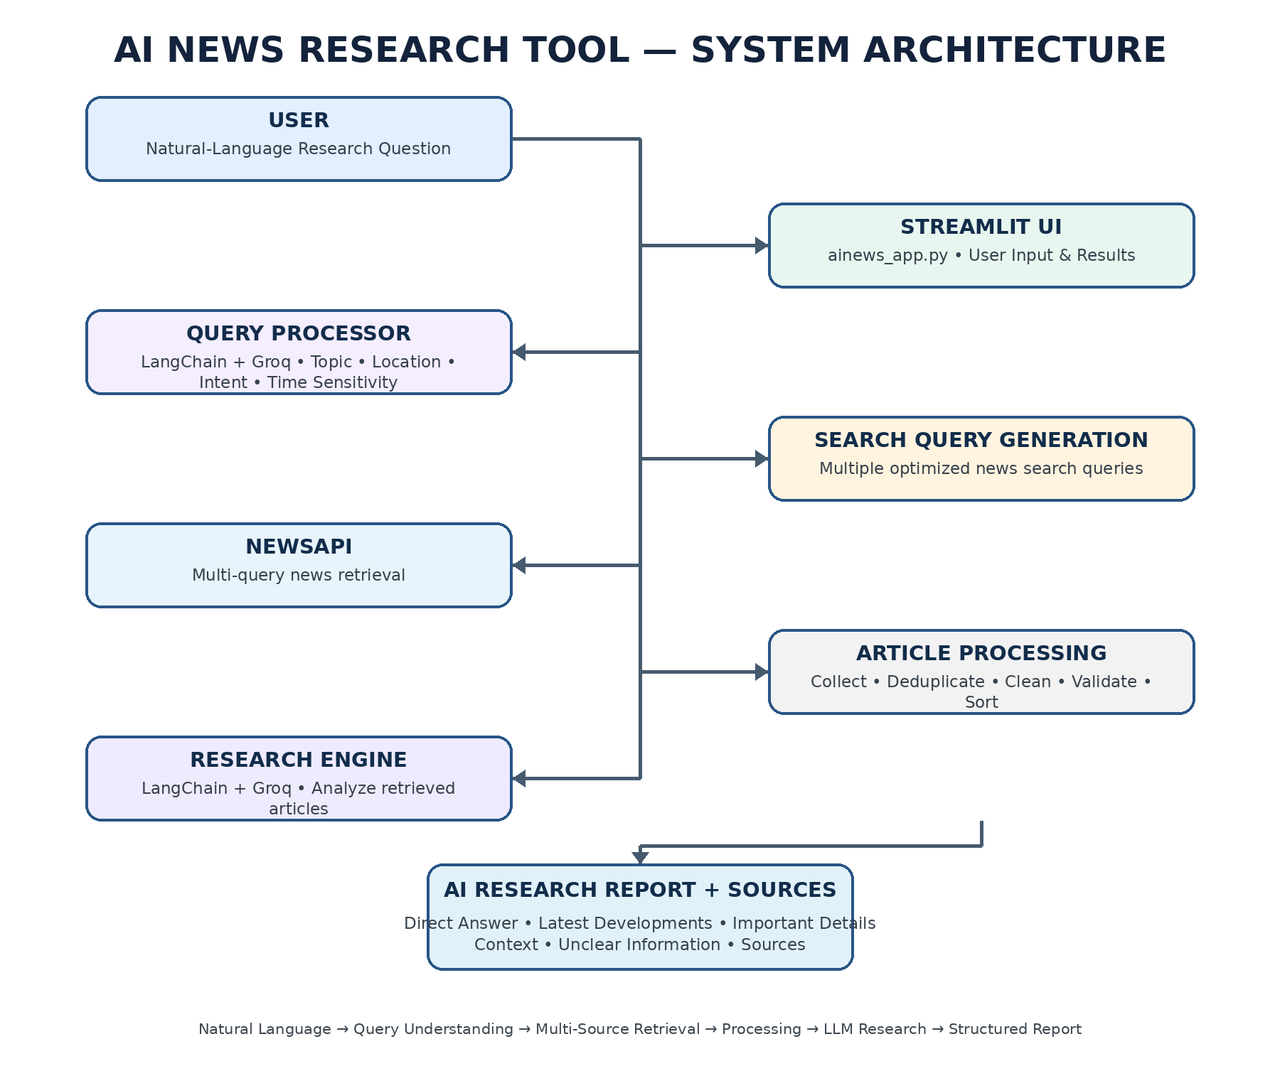
System Architecture

Slide 9
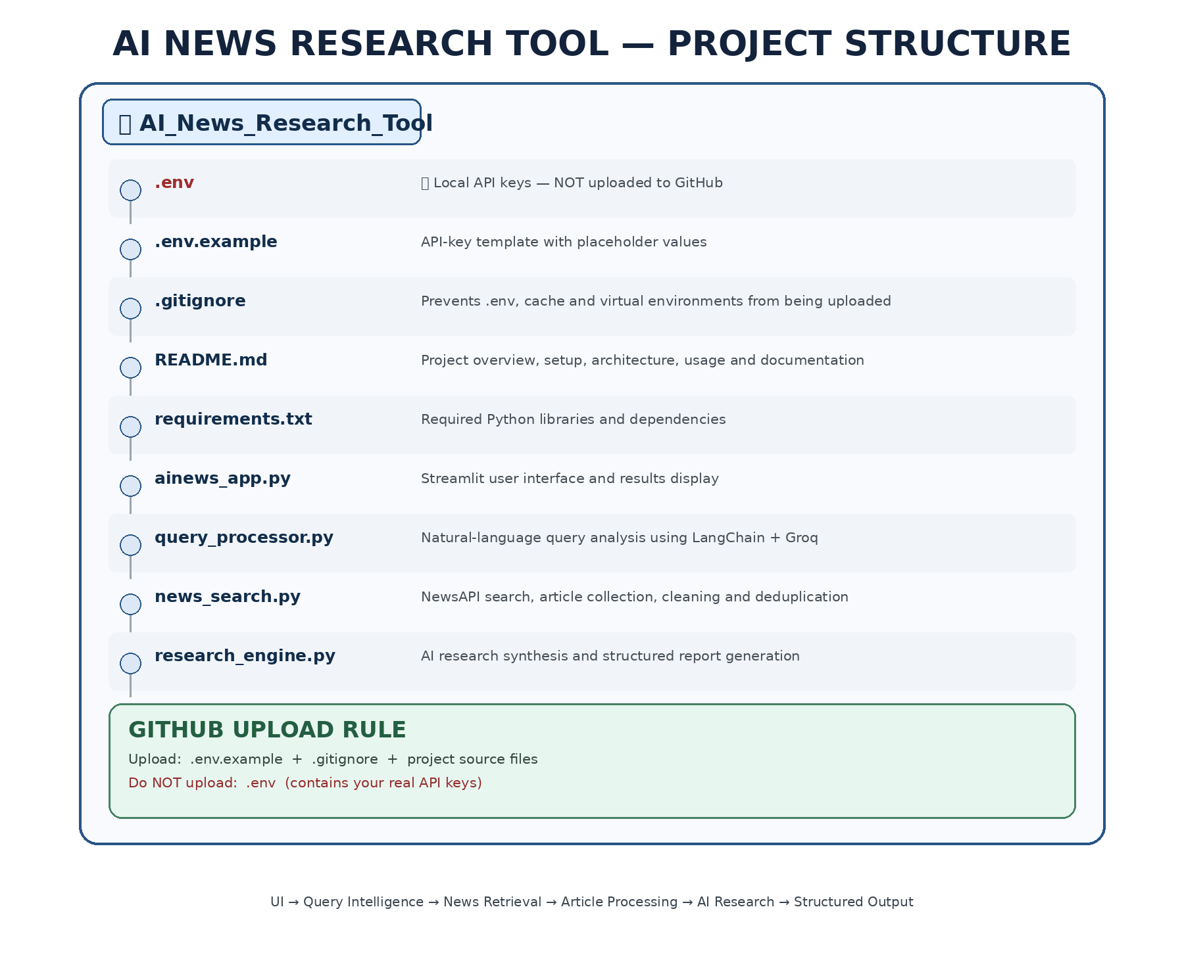
Project Structure

Slide 10
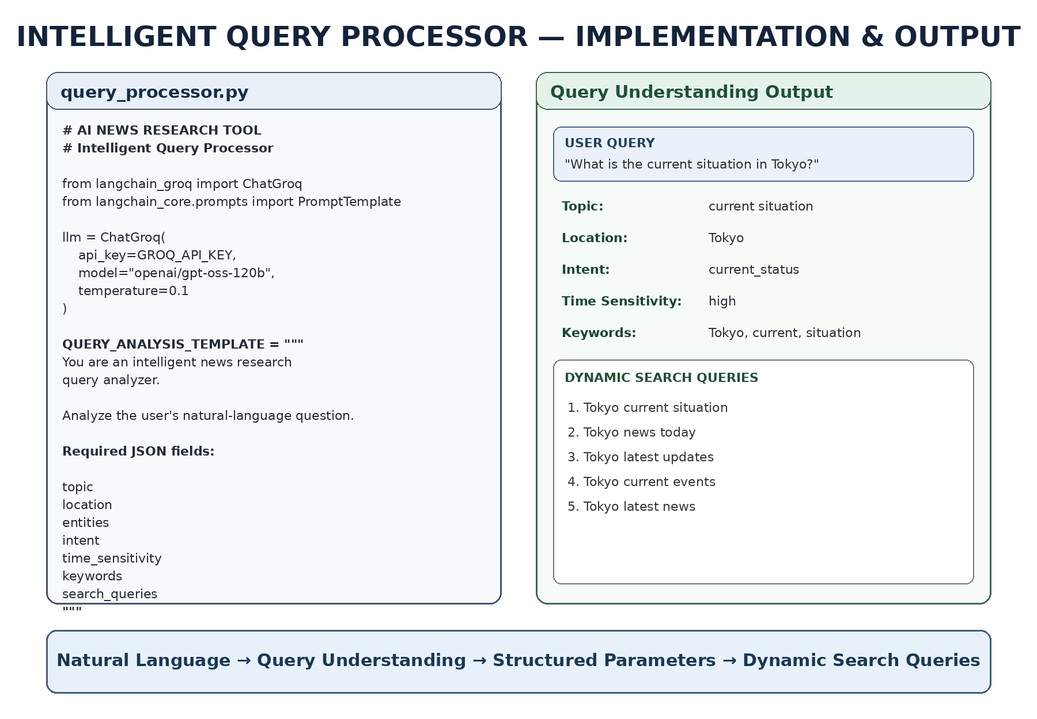
Intelligent Query Understanding

Slide 11

Dynamic Search Query Generation
Tokyo current situation
Tokyo news today
Tokyo latest updates
Tokyo current events
Tokyo latest news
“The application does not contain special conditions for Japan, Tokyo, Odisha or any other location. The location is dynamically extracted from the user's question, and the LLM generates suitable search queries.”

Slide 12

NewsAPI Integration
Generated Search Queries
↓
NewsAPI
↓
Multiple Search Requests
↓
Article Collection
↓
Duplicate Removal
↓
Article Cleaning
“The application sends multiple search queries to NewsAPI rather than depending on one search phrase. The retrieved articles are then combined, cleaned and deduplicated.”

Slide 13

Article Cleaning & Deduplication
“Because multiple search queries can return the same article, duplicate removal is important. We use the article URL or title as the identifier and then standardize the article fields.”
Duplicate removal
Articles are identified using:
Article URL
OR
Article Title
Cleaning
The system standardizes:
Title
Description
URL
Source
Published Date
Author
Processing flow
Raw NewsAPI Articles
↓
Remove Empty Articles
↓
Remove Duplicates
↓
Standardize Fields
↓
Clean Article Dataset

Slide 14


AI Research Engine
01
Direct Answer
Answers the user’s question based on retrieved articles.
02
Latest Developments
Summarizes recent developments.
03
Important Details
Highlights important facts, organizations and events.
04
Location/ Topic Context
Provides relevant context.

Slide 15
AI Research Engine
05
Different Reports or Views
Identifies differences between sources
06
What Is Still Unclear
Identifies missing or unconfirmed information.
07
Sources
List the source articles.
“The LLM doesn't simply summarize one article. It receives the user's question, the interpreted topic and location, and the retrieved articles, then creates a structured research report.”

Slide 16
LangChain + Groq
User Query / Retrieved Articles
↓
PromptTemplate
↓
LangChain Chain
↓
ChatGroq
↓
Groq LLM: gpt-oss-120b
↓
Structured AI Output
LangChain:
Used to build the LLM processing pipeline.
Connects prompts with the Groq language model.
Uses the modern Runnable Chain approach
PromptTemplate → LLM → Response

Slide 17
LangChain + Groq
1. Query Processing:
Natural Language Query
↓
LangChain + Groq
↓
Topic / Location / Intent /
Time Sensitivity / Keywords /
Search Queries
2. Research Generation:
Retrieved News Articles
↓
LangChain + Groq
↓
Structured AI Research Report
Groq:
Provides the Large Language Model inference.
Current model used: openai/gpt-oss-120b.
Temperature: 0.1
Used for fast and consistent AI processing.

Slide 18
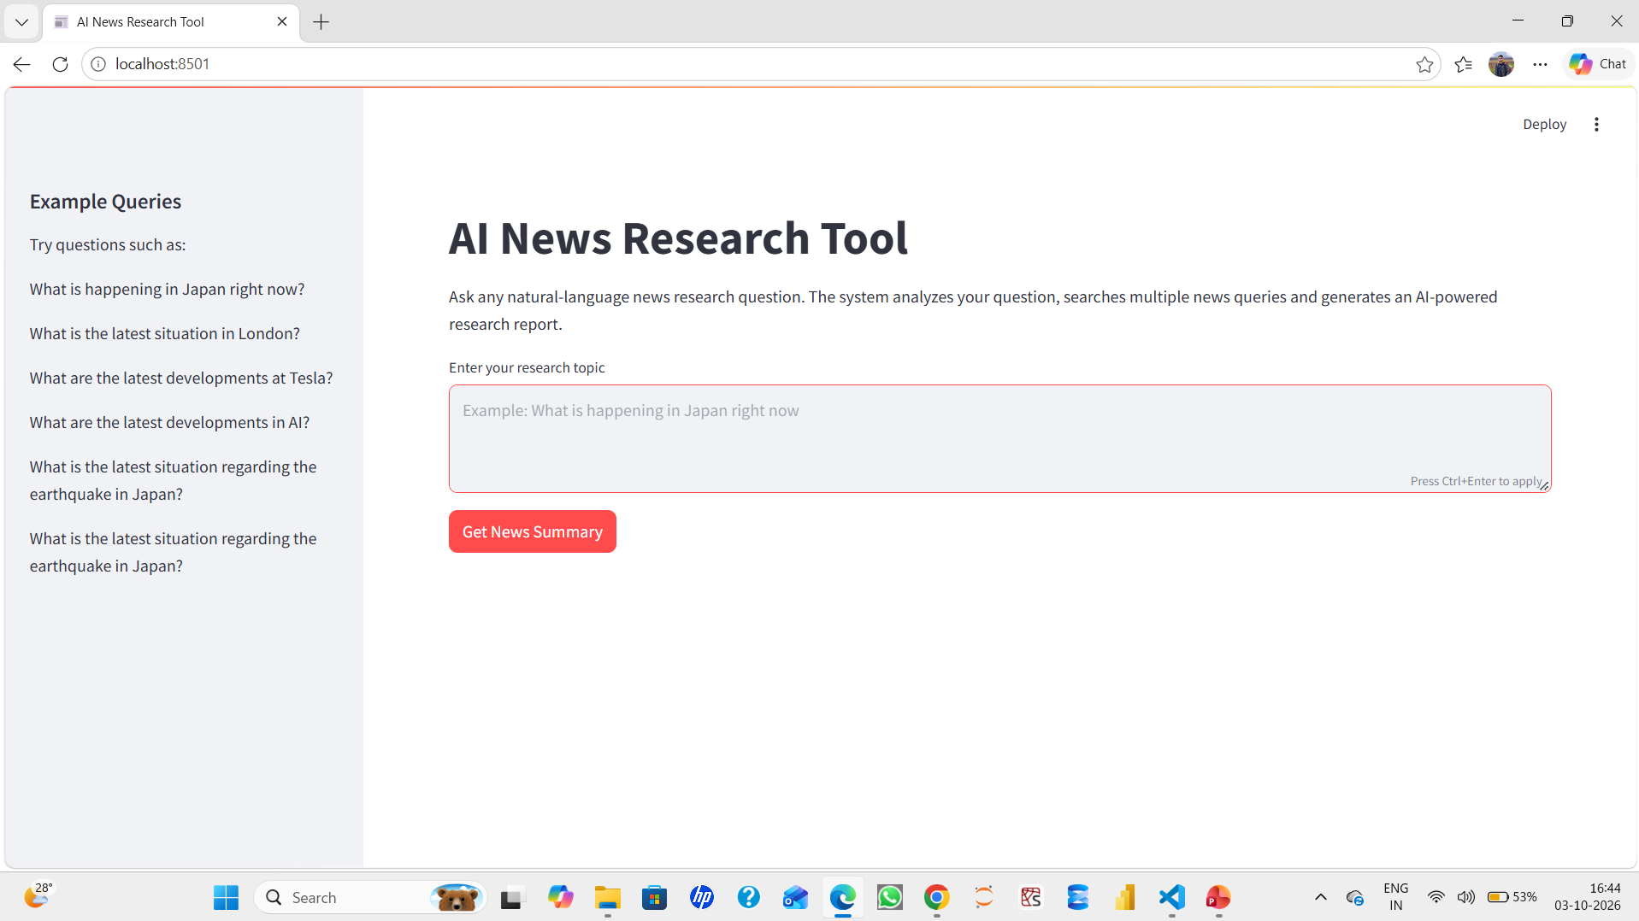
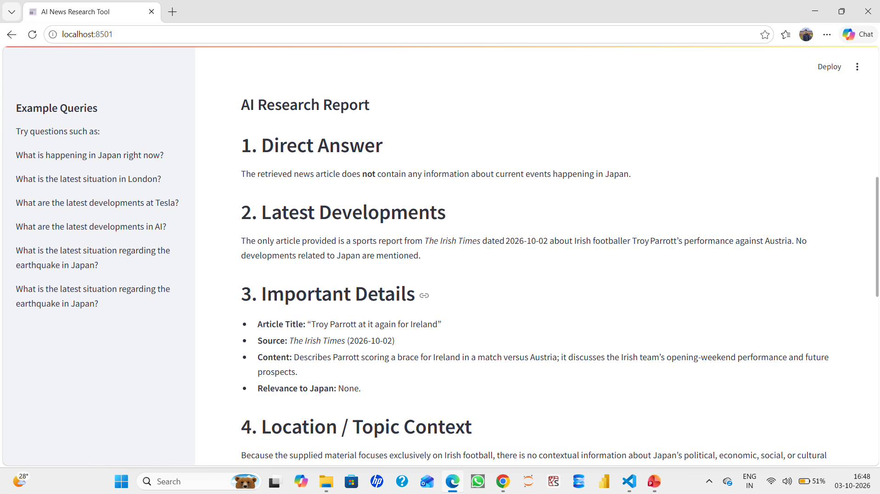
Streamlit Application
Research Question Input
Enter your research question
Get News Summary
Get News Summary
Query Understanding
Shows:
Topic
Location
Intent
Time sensitivity
Generated Search Queries
Displays the queries created by the system
AI Research Report
Displays the generated report
Source Articles
Source
Data
Description
Article URL

Slide 19
Testing & Validation
“Testing is performed across different categories instead of testing only one location. This verifies that the application is generic rather than being designed for a particular example.”
Test | Example
Location | Tokyo
Country | Japan
City | London
Disaster | Earthquake in Japan
Company | Tesla
Technology | Artificial Intelligence
Economy | Global economy
General News | Latest News
Functional checks
Query accepted
Query analysed
Location extracted
Search queries generated
NewsAPI called
Articles retrieved
Duplicate articles removed
AI report generated
Source links displayed
Empty query handled
No-result condition handles

Slide 20
Challenges & Solutions
“One of the major technical challenges was that the latest LangChain version differs from older examples. Instead of using the deprecated LLMChain approach, the project uses PromptTemplate and the modern runnable pipeline.”
Challenge | Solution
LangChain API changes | Modern runnable pipeline
Natural-language questions | LLM query analyzer
Different locations | Dynamic location extraction
Poor search queries | Multiple generated queries
Duplicate articles | URL/title deduplication
Missing API keys | .env configuration
No search results | Fallback handling
JSON generation issues | JSON cleaning + fallback
Streamlit errors | Modular backend structure

Slide 21
Future Enhancements
Authentication:
User login and access control
Export
Export research reports to:
PDF
Word
CSV
Historical Analysis
Compare news trends over time
Multilingual Support
Support questions and news in multiple languages
Source Ranking
Rank sources based on relevancy and recency
News Analytics
Chats for:
News volume
Topics
Locations
Trends
Deployment
Deploy the application to a cloud platform

Slide 22
Conclusion
“This project demonstrates how an LLM can be combined with external APIs and a web interface to create a practical AI application. The main strength of the system is that it can understand natural-language research questions and dynamically convert them into news searches.”
The AI News Research Tool provides an end-to-end automated research workflow:
Natural Language Question
↓
Intelligent Query Understanding
↓
Dynamic Search Query Generation
↓
NewsAPI Retrieval
↓
Cleaning & Deduplication
↓
LLM-Based Research
↓
Structured Report
↓
Source Articles
Key learning outcomes:
LLM application development
LangChain
Prompt engineering
API integration
Natural-language processing
News data processing
Streamlit development
Error handling
Modular Python architecture
Secure API-key management

Slide 23
Thank You
Grateful for your time and attention.
Your feedback and insights are deeply appreciated!
Mr. Ajay Kumar Sahu
7735335935
ajaykumarsahu2017.1997@gmail.com

